Slide 1

Heart Disease Diagnostic Analysis
Name = Vardhan.m.k email = vardhankatrik@gmail.com

Slide 2

Introduction
analysis on hearth patient
analysis according to their age ,sex , etc
Ground analysis

Slide 3
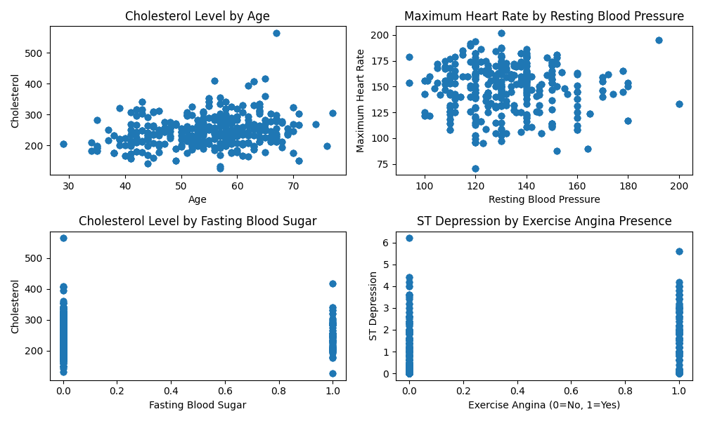
analysis on patient
The following graphs shows the analysis done on patient catagrizod by
Cholesterol level by age
Maximum heart rate by resting blood pressure
Cholesterol level by fasting blood sugar
St Depression by exercise angina presence

Slide 4
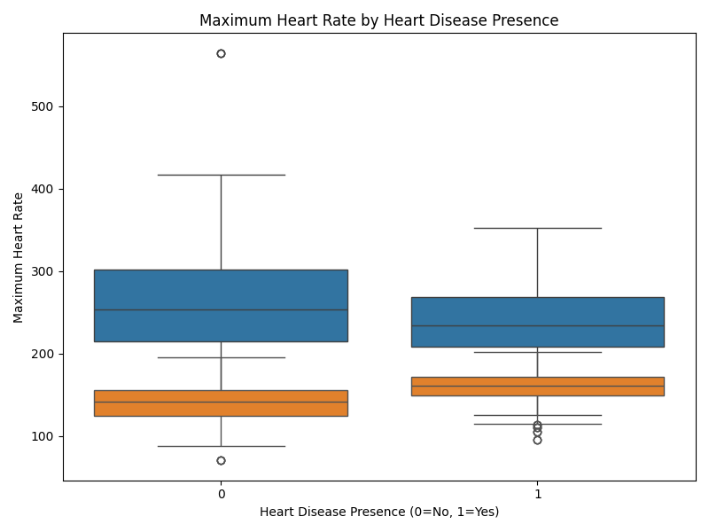
Maximum heart rate by heart disease presence
The following graph shows the maximum heart rate by disease
Patient
on basis of 25%,50%,75%
0 is not heart disease presence 1 is heart disease presence

Slide 5
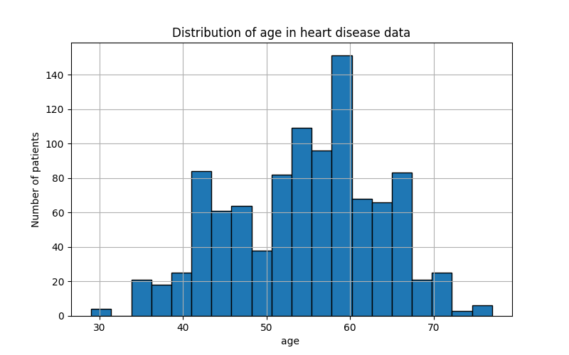
Distribution of age in heart disease data
The graph show the distribution of age in heart disease data
Which includes that patient of age 60 are the most present in heart disease data
Hence have most chance for heart disease like heart attack, heart stroke , etc

Slide 6
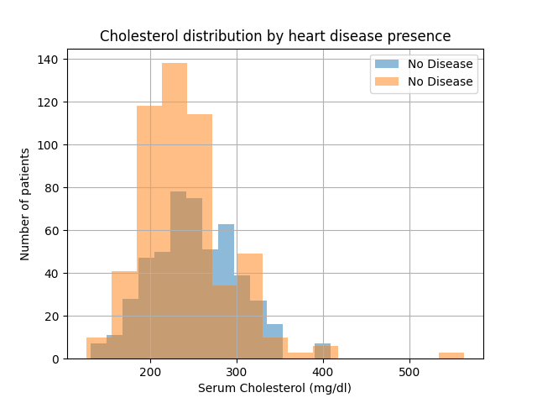
Cholesterol distribution by heart disease presence
The following graph shows the Cholesterol level
In the health data
As the Cholesterol level is one of the main reason
Of heart disease

Slide 7
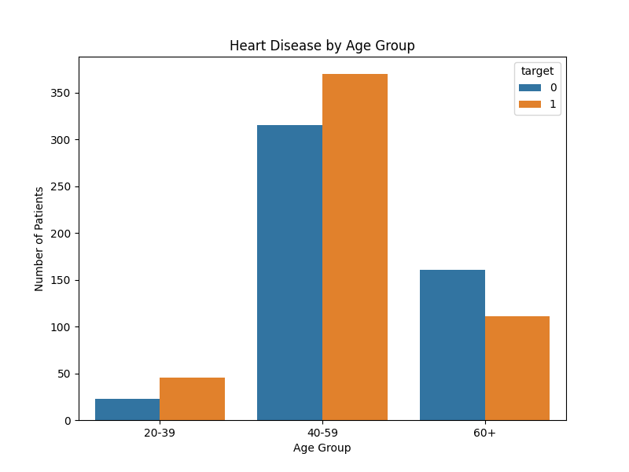
Heart disease by age group
The graph shows the heart disease patient by their age group 20-39
40-59
60+
As we can see the people under the age group
40-59 are most
Hence have most chance for heart disease like heart attack, heart stroke , etc

Slide 8
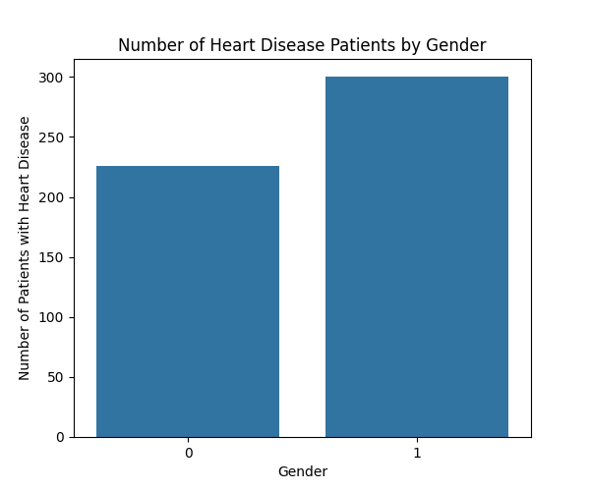
Number of heart disease patients by gender
This graph shows the distribution of the health data by gender
Where Male =1
And Female = 0
Which shows that male are most with heart disease

Slide 9

Thank you

